Slide 1
Computer Modeling and Simulation
Lecture 14 & 15

Slide 2
Discrete Distributions with equal probability of all events
If an equal likelihood of each of several discrete events exists, in a simulation we can generate a random integer to indicate the choice.
For example, in a simulation of a pollen grain moving in a fluid, suppose at the next time step the grain is just as likely to move in any direction—north, east, south, west, up, or down—in a three-dimensional (3D) grid.
A probability of 1/6 exists for the grain to move in any of the six directions.
With these equal probabilities, we can generate a uniformly distributed integer between 1 and 6 to indicate the direction of movement.
Thus to simulate discrete distributions where every event has equal chance to exist, generate a uniform random integer from a sequence of n integers, where each integer corresponds to an event.

Slide 3
Discrete Distributions with varying probability of events
Frequently, however, the discrete choices do not carry equal probabilities.
For example, in an initial 3D grid, suppose only 15% of the grid sites, or cells, contain pollen grains. Thus, a probPollen = 15% = 0.15 chance exists for a cell to contain a grain.
If the location is to contain a pollen grain, we make the cell’s value equal to POLLEN = 1; otherwise, the cell’s value becomes EMPTY = 0.
To initialize a grid for a simulation, we must designate for each cell if the location contains pollen or not.
For each cell, we need to generate a uniformly distributed random floating-point number from 0.0 up to 1.0. On the average, 15% of the time this random number is less than 0.15, while 85% of the time the number is greater than or equal to 0.15.
Thus, to initialize the cell, if the random number is less than 0.15, we make the cell’s value POLLEN; otherwise, we assign EMPTY to the cell’s value.

Slide 4
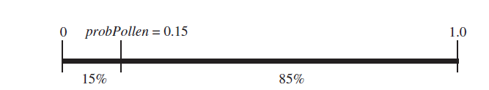
Discrete Distributions with varying probability of events
Using the probabilities and cell values, employ the following logic is employed to initialize each cell in the grid:
if a random number is less than probPollen (i.e., pollen grain at site)
set the cell’s value to POLLEN
else (i.e., no pollen grain at site)
set the cell’s value to EMPTY
Fig: 15% of floating-point values between 0 and 1 are less than probPollen = 0.15

Slide 5
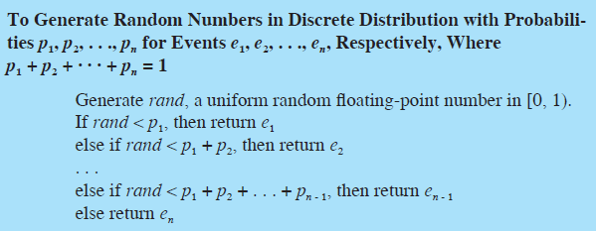
Discrete Simulations with varying probabilities

Slide 6

Normal Distribution
A normal, or Gaussian, distribution, which statistics frequently employs, has a probability density function where μ is the mean and σ is the standard deviation of the form .

Slide 7
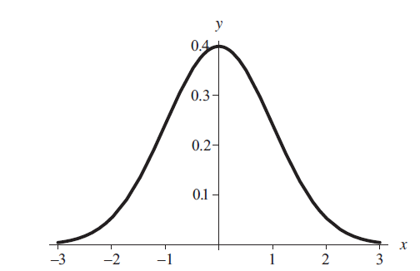
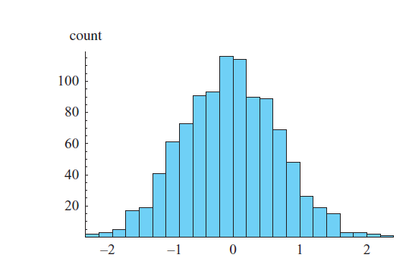
Normal Distribution
Below figure displays a histogram of a set of 1000 random numbers in the Gaussian distribution with mean 0 and standard deviation 1.
68.3% of the values in a normal distribution are within ±σ of the mean, μ; 95.5% are within ±2σ of μ; and 99.7% are within ±3σ of μ.
Fig: Probability density function for normal distribution
with mean 0 and standard deviation 1
Fig: Histogram of a normal distribution with mean 0 and standard deviation 1

Slide 8
Generating Random Numbers in Normal Distribution
The Box-Muller-Gauss method can be employed to generate numbers in a normal distribution.
The method first generates a uniformly distributed random number, a, between 0 and 2π.
Then, the technique computes b, the product of the standard deviation (σ) and the square root of the negative natural logarithm of a uniformly distributed random number between 0.0 and 1.0.

Slide 9
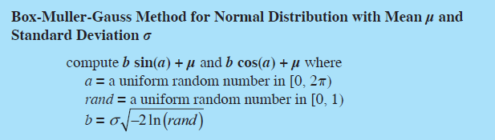
Box-Muller-Gauss method
The two values b · sin(a) + μ and b · cos(a) + μ are normally distributed with mean μ and standard deviation σ.

Slide 10
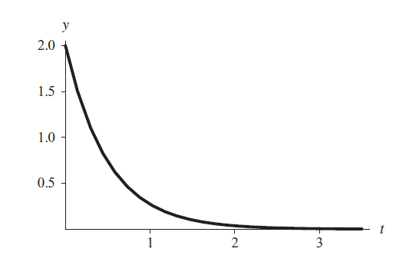
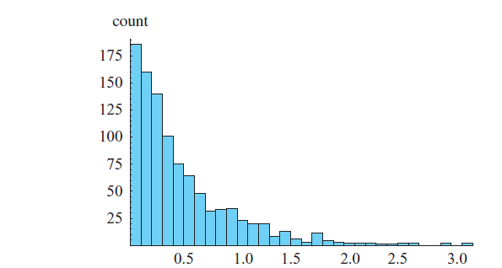
Exponential Distribution
Functions of the form f(t) = |r|e^{rt} with r < 0 and t > 0, or f(t) = |r|e^{rt} with r > 0 and t < 0 are probability density functions in which the area under each curve is 1.
Figure on the left contains the graph of a function in this category, f(t) = 2e–2t. Figure on the right displays a histogram of 1000 such exponentially distributed random numbers.
Fig. Histogram of 1000 random numbers ln(rand)/(–2), where rand is a uniformly generated random number in [0.0, 1.0)
Fig. Probability density function f(t) = 2e–2t for t > 0

Slide 11
Generating Random Numbers in Normal Distribution
To obtain a number in such a distribution, the exponential method divides the natural logarithm of a uniformly distributed random number from 0.0 to 1.0 by the rate constant (r), that is, ln(rand)/r, where rand is random between 0 and 1.
For example, to generate numbers in the distribution f(t) = 2e^{–2t}, we calculate ln(rand)/(–2).

Slide 12
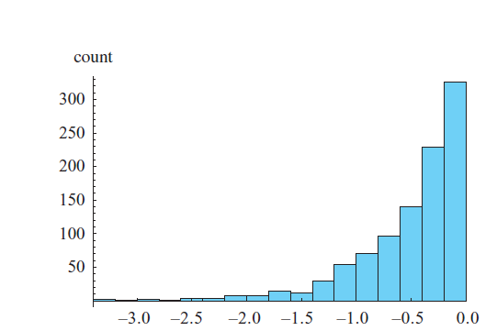
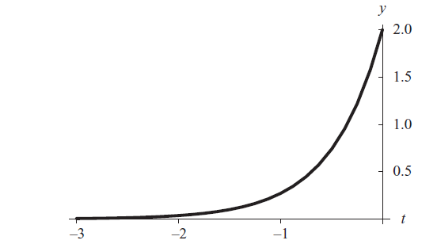
Generating Random Numbers in Exponential Distribution
The same algorithm is employed to generate random numbers from minus infinity to 0 for probability density function f(t) = |r|e^{rt} = re^{rt} with r > 0.
Figure on the left shows the graph of one such function, f(t) = 2e^{2t}; and Figure on the right displays a histogram of 1000 pseudorandom numbers that the algorithm ln(rand)/2 generates.
Fig: Histogram of 1000 numbers ln(rand)/2, where rand is a uniformly generated random number in [0.0, 1.0)
Fig: Probability density function f(t) = 2e2t for t < 0

Slide 13
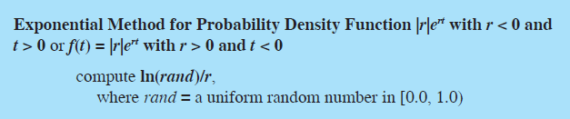
Probability density function for Exponential Distribution

Slide 14
Step 1:
If this distribution is known or sufficient data exist to derive it, then this step is straightforward.
However, if the behavior of an input variable is not well understood, then the modeler might have to estimate this distribution based on empirical observation or subject matter expertise.
The modeler may also use a uniform distribution if he or she is lacking any specific knowledge of the variable ’ s characteristics.
When additional information is gathered to define the variable, then the uniform distribution can be replaced.

Slide 15
Step 2:
Step 2 Generate inputs randomly from those distributions.
Step 2 requires randomly sampling each input variable ’ s distribution many times to develop a vector of inputs for each variable.
Suppose we have two input random variables X and Z.
After sampling n times, we have X = (x₁, x₂,… , x_{n}) and Z = (z₁, z₂, … , z_{n}).
Elements from these vectors are then sequentially chosen as inputs to the function defining the model.
The question of how large n should be is an important one because the number of samples determines the power of the output test statistic.
As the number of samples increases, the standard deviation of the test statistic decreases.
In other words, there is less variance in the output with larger sample sizes.
However, the increase in power is not linear with the number of samples so there is a point when more sampling provides little improvement.

Slide 16
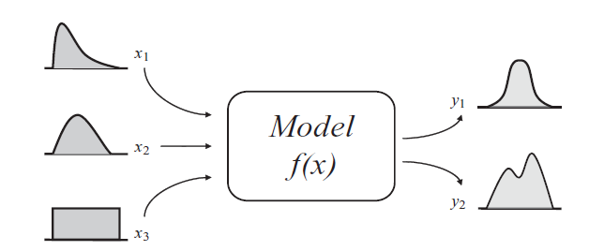
Basic Monte Carlo Model

Slide 17
Steps 3 and 4
Step 3 is straightforward. It involves sequentially choosing elements from the randomly generated input vectors and computing the value of the output variable or variables until all n outputs are generated for each output variable.
Step 4 involves aggregating all these outputs. Suppose we have one output variable Y. Then we would have as a result of step 4 an output vector Y = (y1,y2, … , yn).
We can then perform a variety of statistical tests on Y to analyze this output.

Slide 18
Components in Monte Carlo Simulation
This four - step method requires having the necessary components in place to achieve the final result. These components may include:
(1) probability distribution functions (pdfs) for each random variable.
(2) a random number generator
(3) a sampling rule— a prescription for sampling from the pdfs
(4) scoring— a method for combining the results of each run into the final result
(5) error estimation— an estimate of the statistical error of the simulation
output as a function of the number of simulation runs and other
parameters.

Slide 19
Sensitivity Analysis
Sensitivity analysis is the study of how uncertainty in a model ’ s output can be assigned to the various sources of input uncertainty.
Input and output uncertainties are at the heart of the Monte Carlo simulation.
Gauging which input random variables have the most inﬂuence on the output random variables is an important fact to know when trying to analyze a model ’ s behavior.

Slide 20
Sensitivity Analysis
It can help uncover model errors and identify important bounds on input variables.
It can help uncover model errors and identify important bounds on input variables. This analysis

Slide 21
Example
Let us suppose we want to predict a product ’ s earning in future years given sales data accumulated over the last 5 years.
A product ’ s earning is a function of unit price , unit sales , variable costs , and ﬁxed costs .
earning = (unit price) × (unit costs) − (variable cost s + ﬁ xed costs).
We will assume that variables used to calculate earnings are all independent of one another. The last 5 years of data for these variables are shown in the following data .

Slide 22
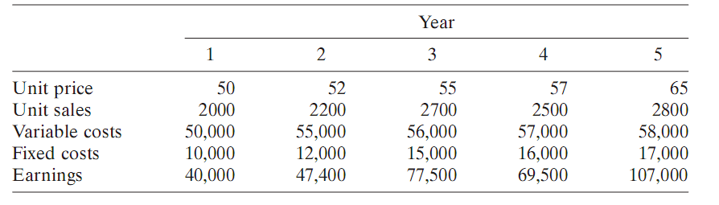
Table: Product earnings by year

Slide 23
Triangular Distribution of input variables
From these data, one can develop a probability distribution to represent each of the input variables.
An appropriate distribution representation would be a triangular distribution , which is typically used when only a small amount of data is available to characterize the input variables.
Constructing a triangular distribution requires three values: a minimum, a maximum, and a most likely or mode. We can represent these values by a , b , and c , respectively.

Slide 24
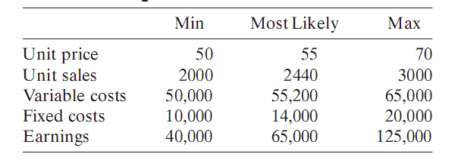
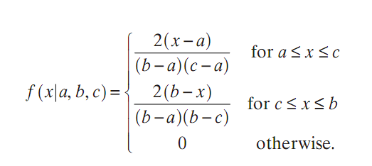
Table: Triangular distribution data

Slide 25
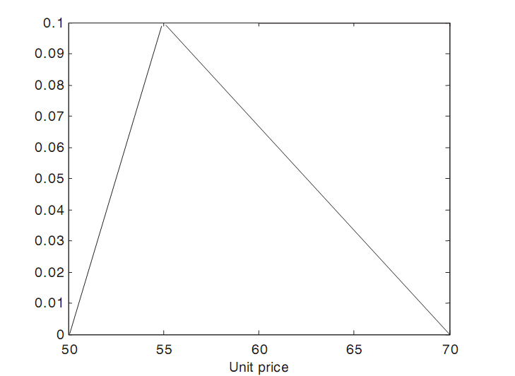
Unit price triangular distribution.

Slide 26
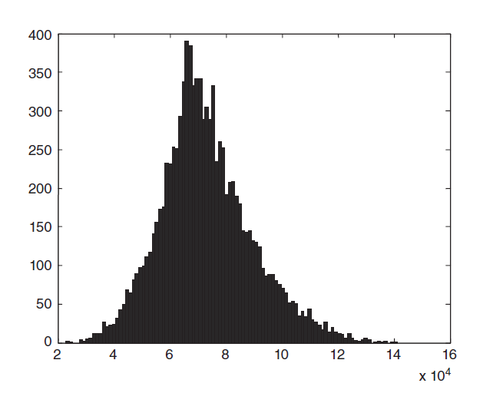
Plot for the earnings

Slide 27
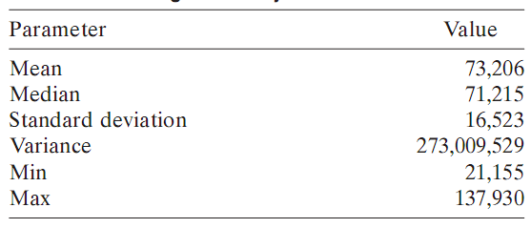
Statistics for the output variable
Using these triangular distributions, 10,000 samples were generated and used to compute predicted future earnings.
The summary statistics for the output variable earnings are shown in the following table.
Notes:
<number>

Slide 28
Sensitivity Analysis – Scatter Plot
One simple method involves a visual assessment of an input variable’s effect on an output variable.
This method employs a scatter plot where each input variable in the Monte Carlo simulation is individually plotted against the output variable and the resulting pattern is analyzed.
The more structured the output pattern, the more sensitive is the output variable to that input variable.

Slide 29
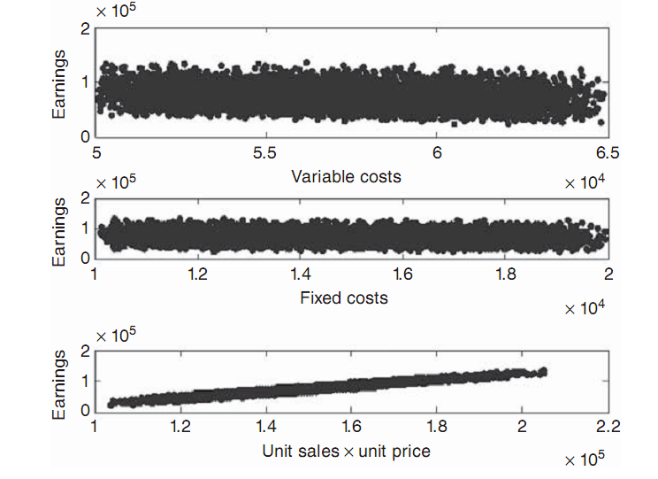
Scatter plots of earnings versus each input variable.

Slide 30
Results of Scatter Plot
The scatter plots show that the variable earnings is more sensitive to the product of unit_price and unit_sales than the ﬁxed and variable costs because of its structured pattern.
From the results of this analysis, one could set the ﬁxed_costs and variable_costs inputs to their mean values and rerun the Monte Carlo simulation using only unit_sales and unit_price as random input variables with little loss in accuracy. The results of this Monte Carlo simulation

Slide 31
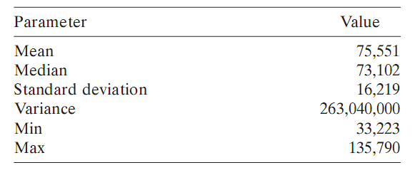
Table: Earning Summary Statistics for the simplified model

Slide 32
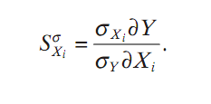
Sensitivity Analysis – Sigma Normalized Derivatives
While scatter plots provide a good visual means for identifying the relative sensitivity among input variables, other computational methods are available that improve on the derivative - based approach mentioned above.
One such approach is the sigma - normalized derivatives . This is deﬁned as follows:
The derivative is normalized by the input – output standard deviations. The larger the result of this computation, the more sensitive the output is to this input.

Slide 33

Sensitivity Analysis – Sigma Normalized Derivatives
When the results of the previous equation are squared and summed across all input variables, the following equation holds:

Slide 34
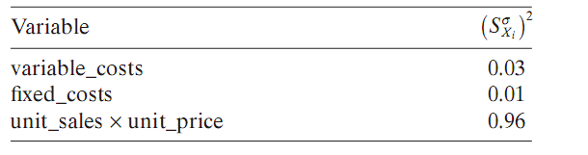
Sigma Normalized Derivatives
As one can see, the product of unit_sales and unit_price is the most sensitive parameter and bears out the results of the scatter plot analysis.
Table: Sigma Normalized Derivatives

